Slide 1
IOT BASED SMART POULTRY FARM

Slide 2
ABSTRACT:
OUR PROJECT IS MAINLY BASED ON
WIFI communication with ESP8266
Calculating the air quality and environmental parameters using sensors
Thing Speak cloud integration between gateway and mobile application
Controlling the devices from anywhere using mobile application
Generating the alerts from mobile application

Slide 3
DESCRIPTION
This project proposes the new model by using advanced modern technology to make traditional chicken farming smarter. Smart farm gives the environmental parameter statistics like temperature, humidity, smoke, weather condition etc. The health of chicken depends on the environment in the poultry farm. If the environmental condition is not suitable then there may be problem with growth of the chicken and there health issues. Poultry farm are design in such way that, environmental conditions can be altered by providing facilities like ventilation, cooling and lightening on rough, wall and floor.

Slide 4
We can remotely monitor environmental parameters in a poultry farm. we can monitor the water level in the tank. Whenever there are extreme conditions this system will warn the person in-charge about the various environmental parameters like temperature, humidity, etc. by sending notifications. And then the person can take necessary actions like switch on the motor for water supply and increasing the light by switching on the lights, vary the temperature levels by switching on fans and blowers through mobile app.

Slide 5
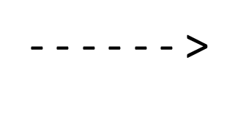
LIGHT
LDR
NODE MCU
OTHER APPLIANCES
Operating device like mobiles
FAN
DHT11
IBM
CLOUD
TO UPLOAD PROGRAMMING AND POWER SUPPLY

Slide 6
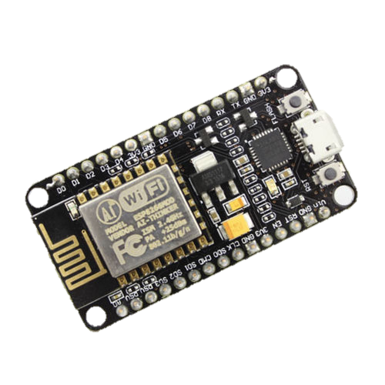
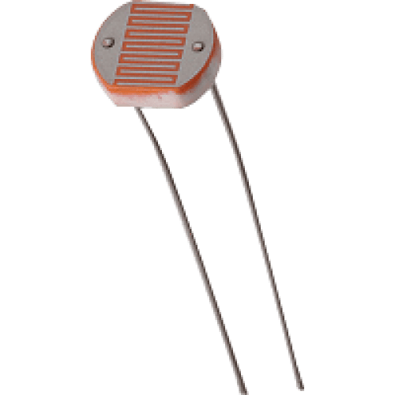
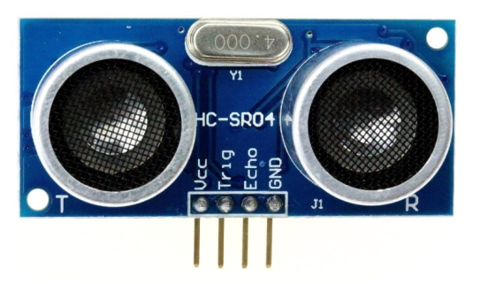
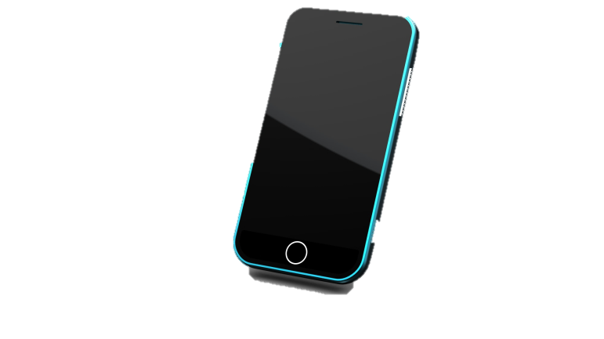
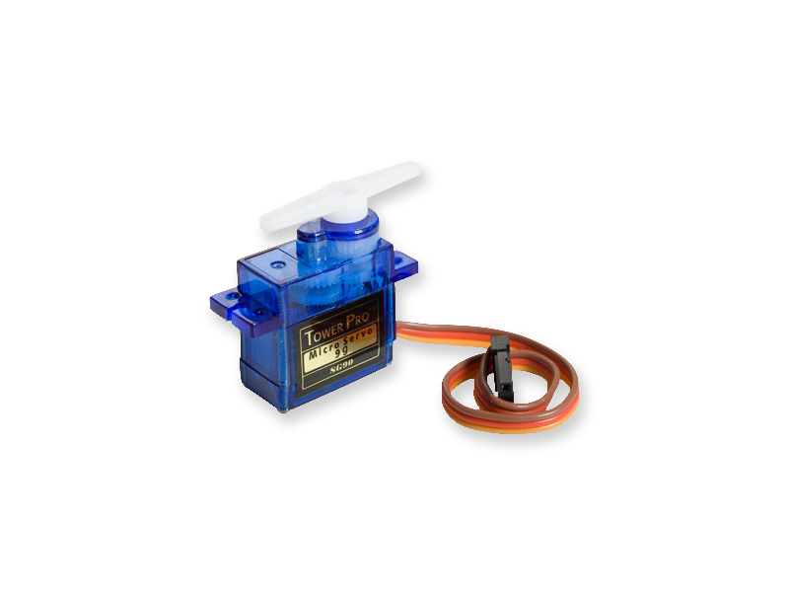
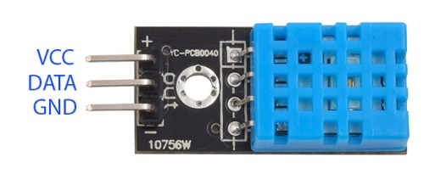
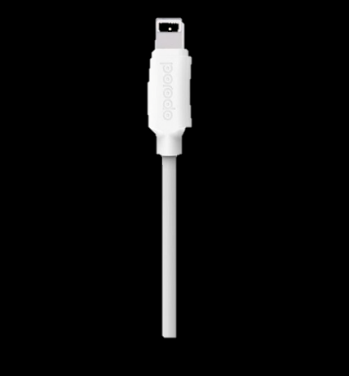
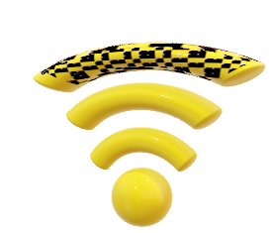
Text notifications
Uploading program through arduino ide/ power supply
This Photo by Unknown Author is licensed under CC BY

Slide 7
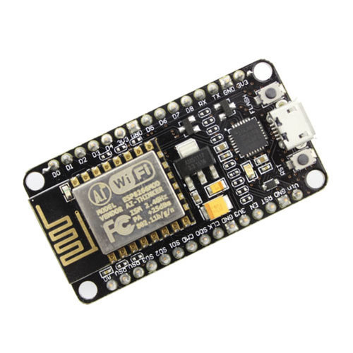

HARDWARE REQUIRED:
ESP8266 module
Ultrasonic sensor
LDR
DHT sensor
Servo motor
LEDS
MQ2

Slide 8
Software’s Required
Arduino IDE
MIT APP INVENTOR

Slide 9
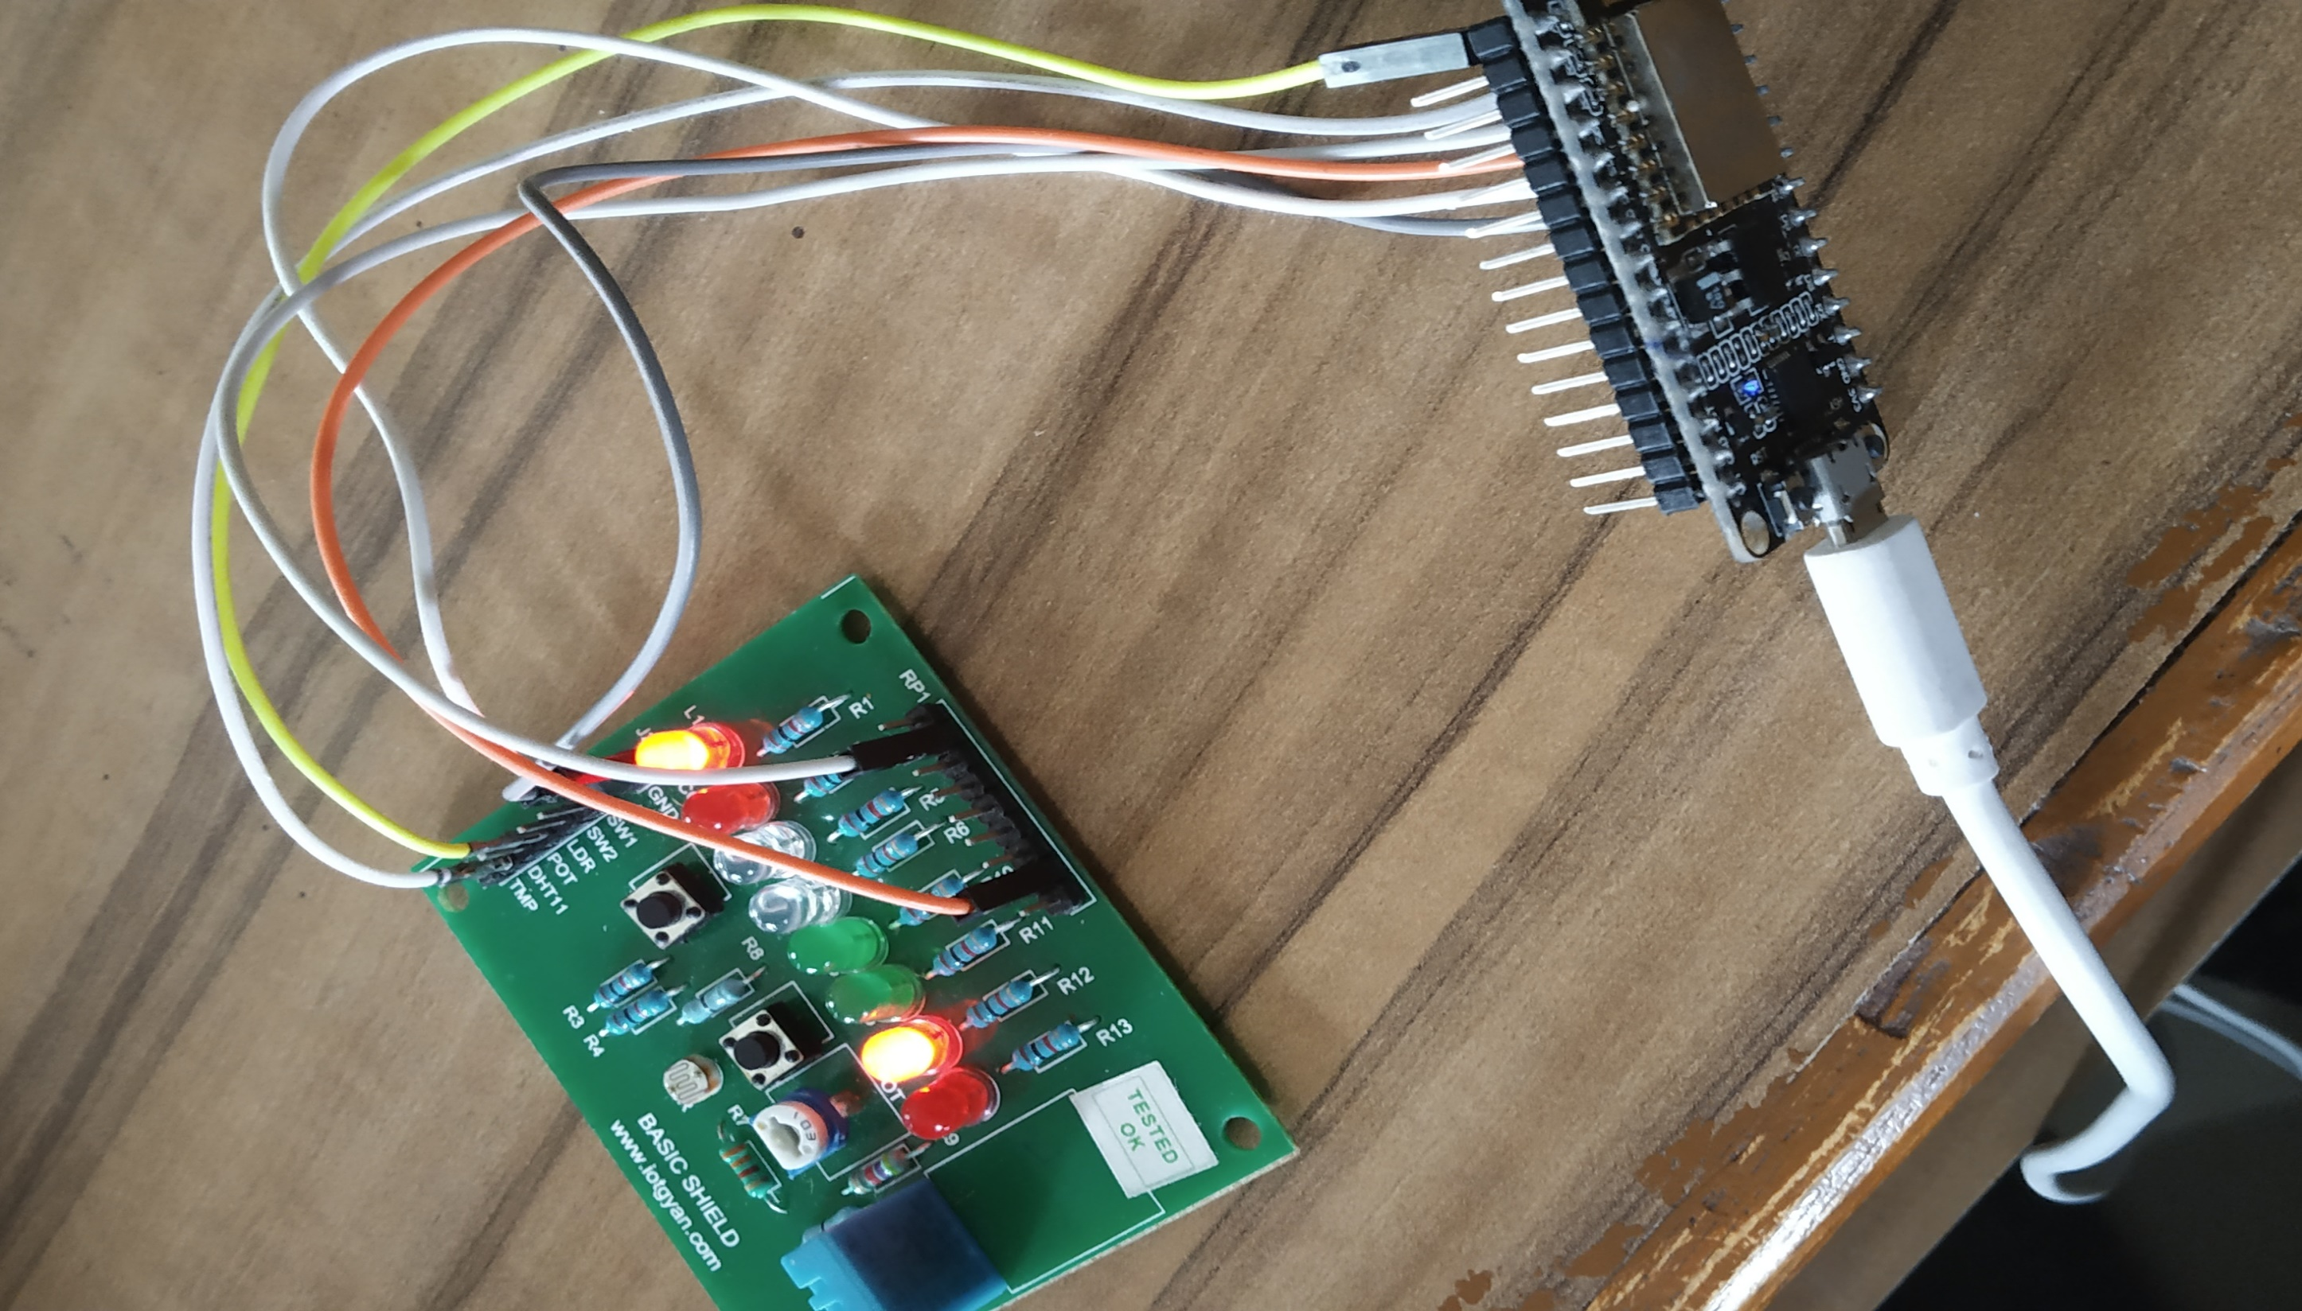

Slide 10
OUTPUTS OF OUR PROJECT

Slide 11
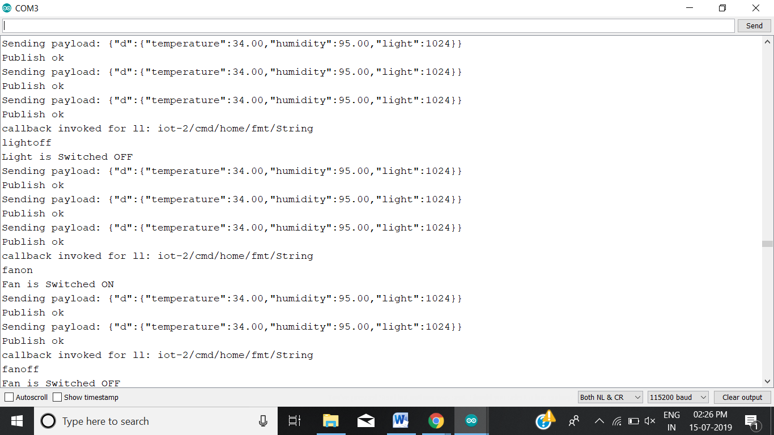
Serial
Moni
tor

Slide 12
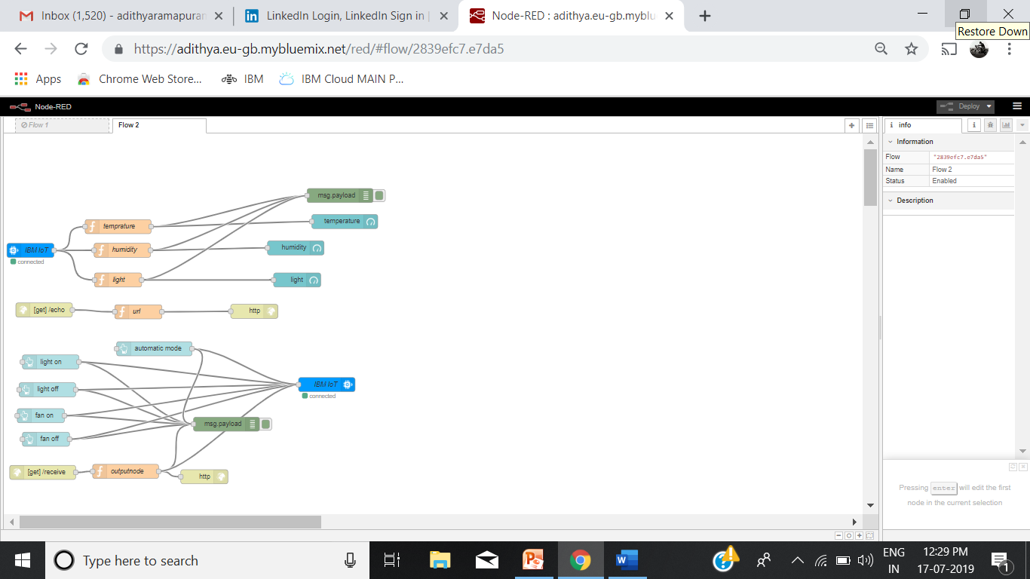
NODE RED FLOW

Slide 13
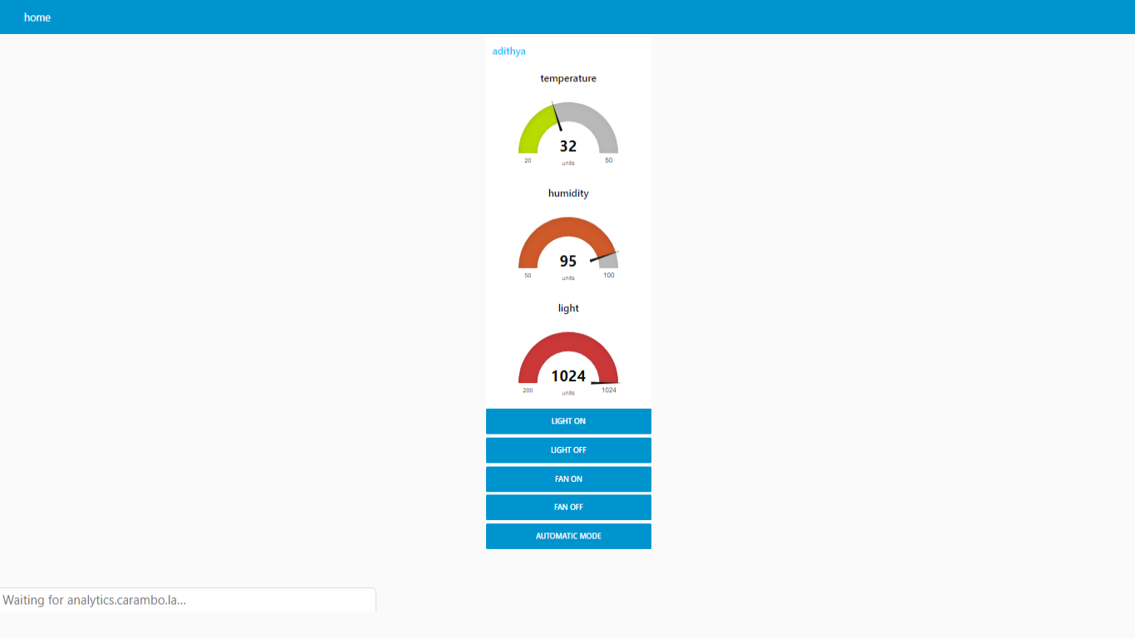
USER INTERFACE

Slide 14
USAGE OF MIT APP

Slide 15
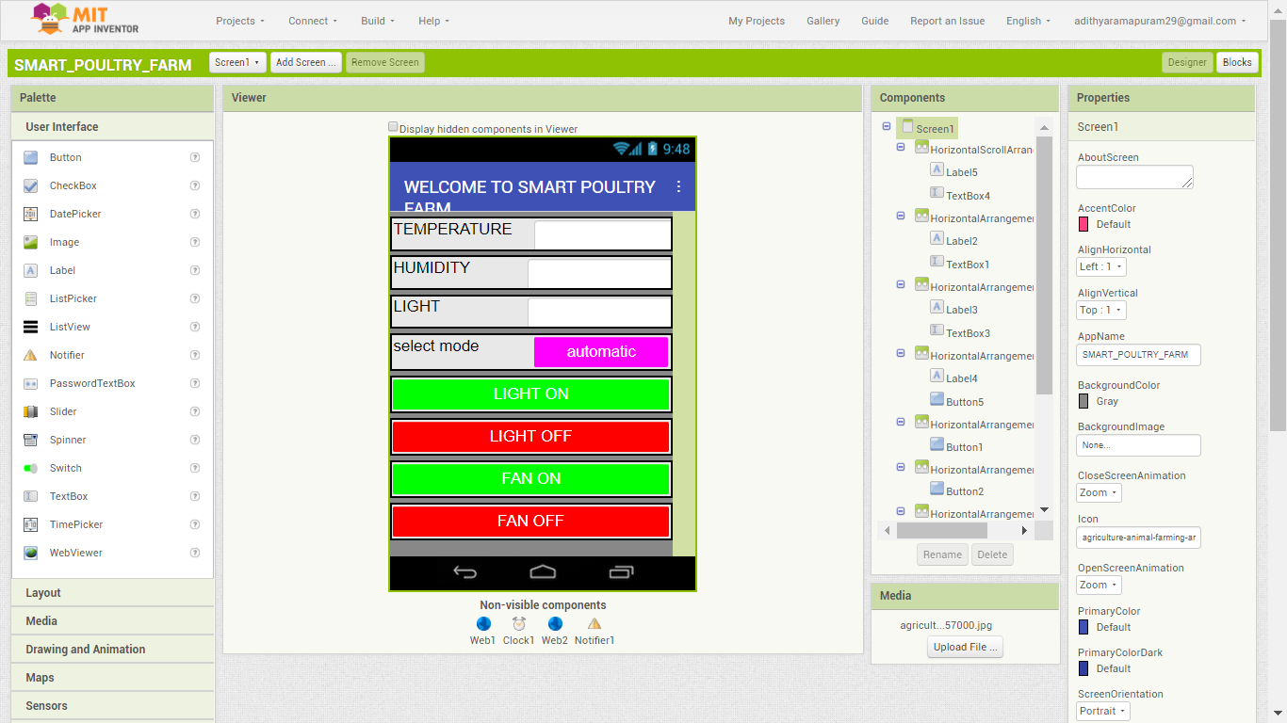

Slide 16
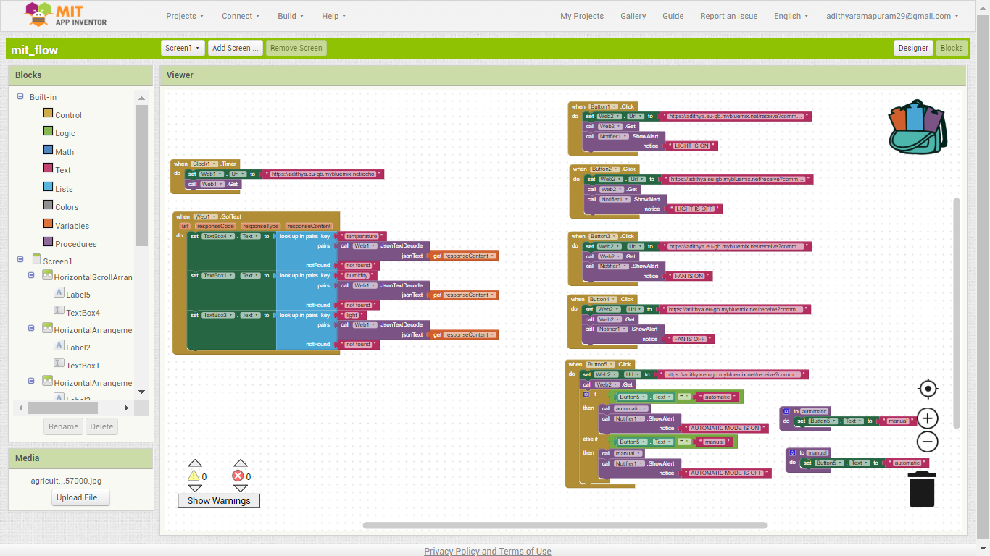

Slide 17


